Slide 1
Foursquare Recommendations from Random Network Walks
Nick Dulchin

Slide 2

Recommendation Systems

Slide 3
Dataset
Foursquare check-ins in New York City
April 3rd, 2012 to February 16th, 2013
Unique users: 1083
Unique venues: 38333

Slide 4
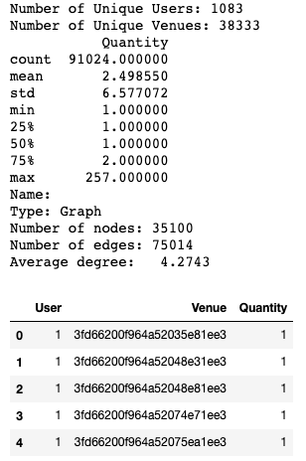
Check-ins per user-venue combination

Slide 5
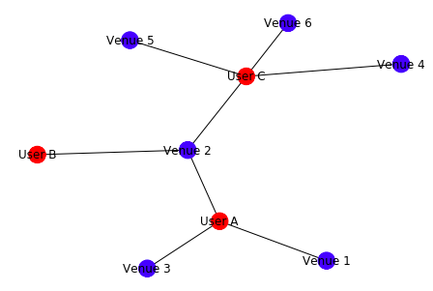
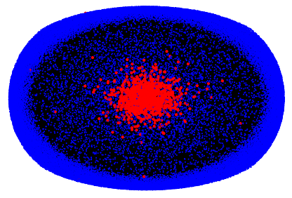
Heterogeneous Network
Red nodes represent users
Blue nodes represent venues
Edges only exist between a user and venue
Edge weight is based on how many times a user checked in at a venue

Slide 6
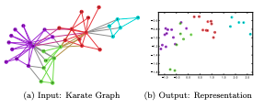
DeepWalk
Algorithm published in 2014
Learns a latent representation of an adjacency matrix using random walks
Uses neural network techniques developed for language modeling

Slide 7
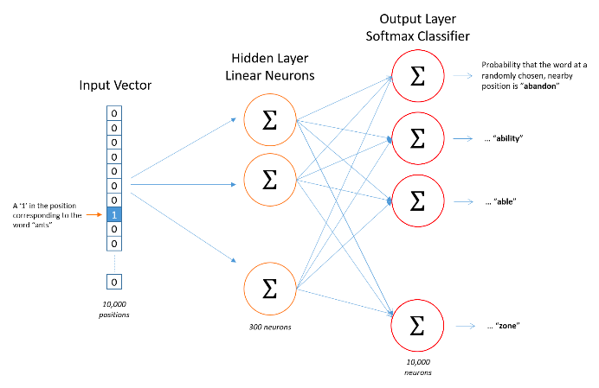
Word2vec
First introduced by Google researchers in 2013
Used for Natural Language Processing
Trains a neural network with one hidden layer

Slide 8
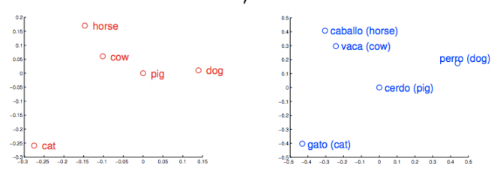
Word2vec

Slide 9

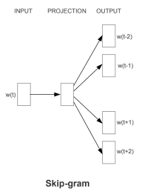
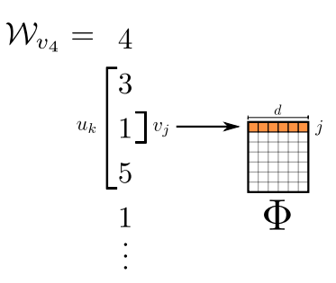
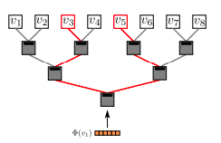
Skipgram/Hierarchical Softmax
Skipgram takes “words” and adjusts weights to predict “words” that will be around it more accurately
Hierarchical softmax reduces computational complexity of the output layer function from:

Slide 10
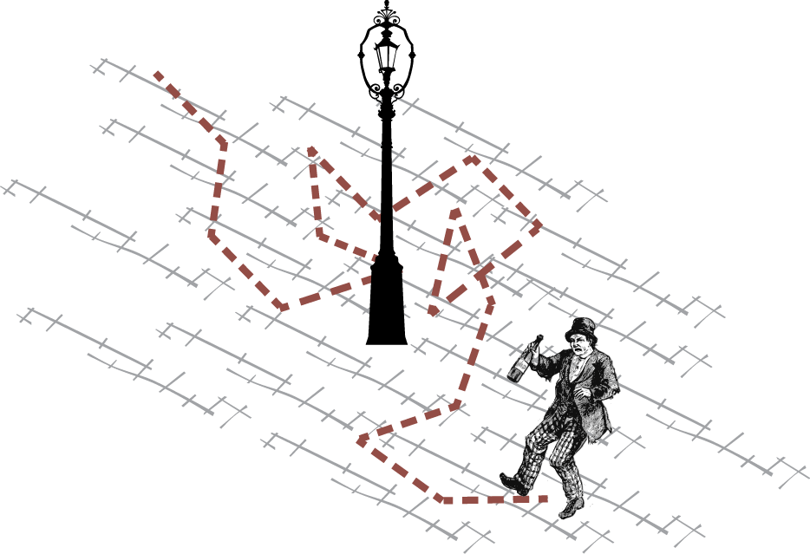
DeepWalk
Random walks are “sentences”

Slide 11
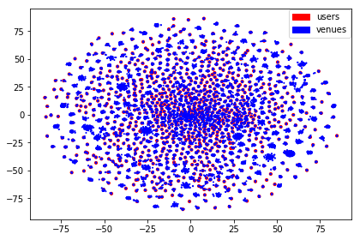
TSNE Visualization

Slide 12
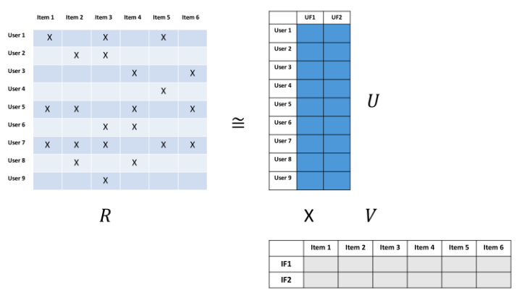
Matrix Factorization

Slide 13
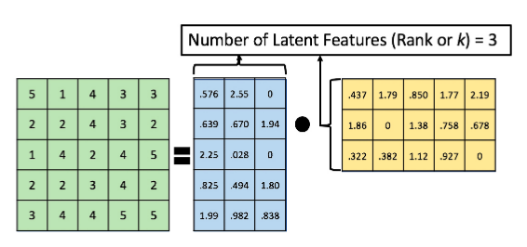
Matrix Factorization

Slide 14
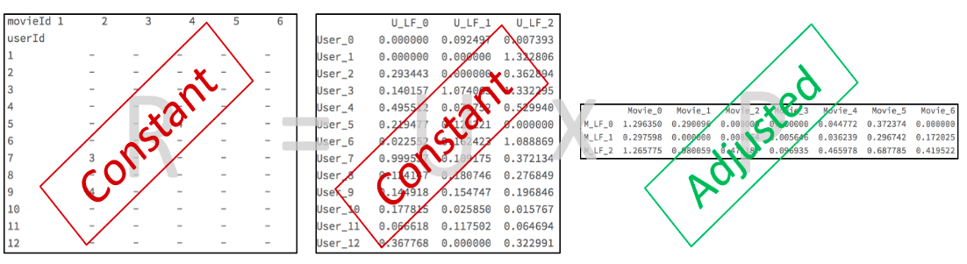
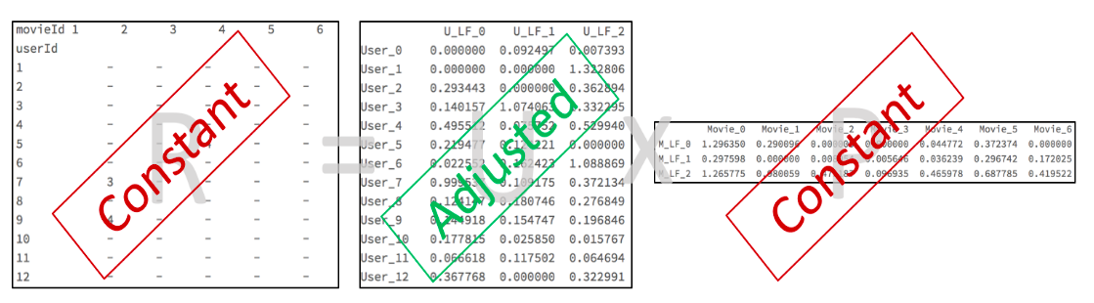
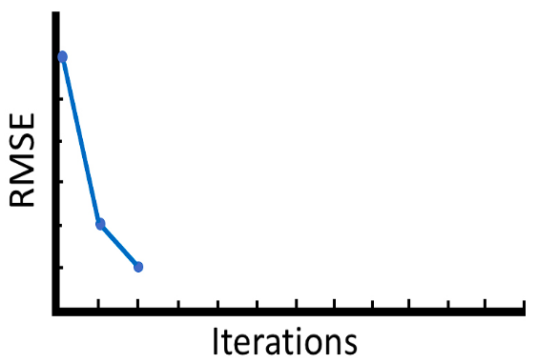
Alternating-Least-Squares

Slide 15
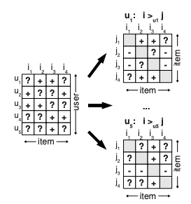
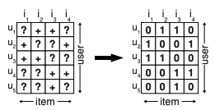
Bayesian Personalized Ranking
Loss function optimized for ranking tasks
VS.

Slide 16
Ranking Criteria
Deepwalk: Cosine similarity in embedding space
Random: Rankings picked totally randomly
ALS: Highest predicted values
BPR: Highest Predicted values

Slide 17
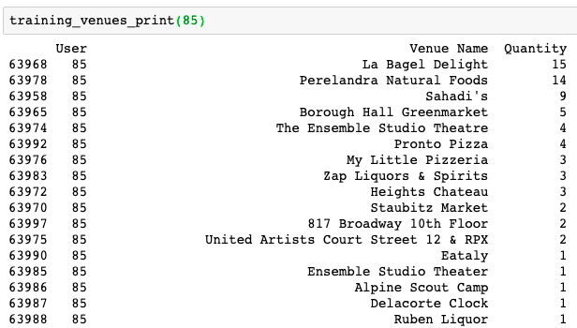
Recommendation Examples

Slide 18
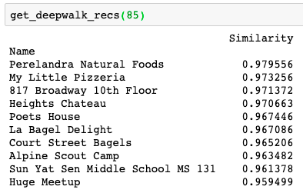
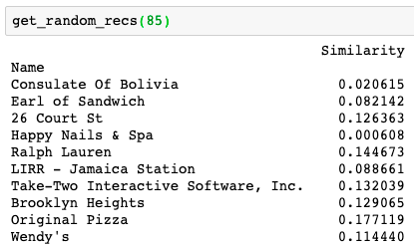
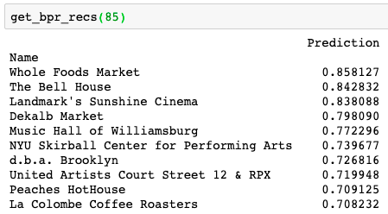
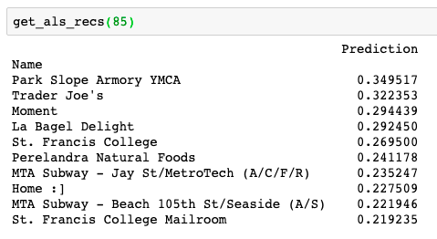
Recommendation examples

Slide 19



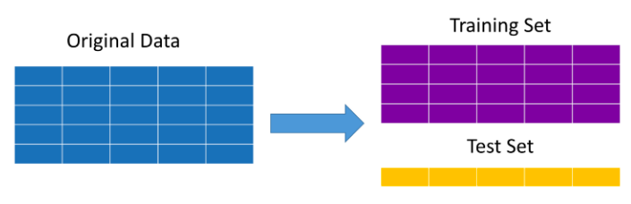
Evaluation Metrics
Metrics are based on recall not precision
Expected Percentile Ranking:
is worse than random
Mean Reciprocal Ranking:
Evaluate using 20% of data held out for testing

Slide 20
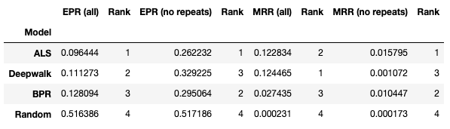
Results

Slide 21
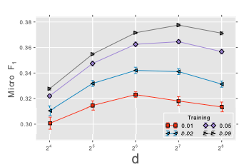
Next Steps
Hyperparameter Tuning to make models perform better
size of output embedding
# of walks/node
length of walks

